Slide 1
Tufel Malik 21BCA19 TY BCA SEM - 5 Adv. Mobile Computing -- 501 / 02
C r y p t o W a l l e t
MINOR PROJECT

Slide 2

INDEX - CONTENT
1 Introduction
1.1 Objective of project
1.2 Project Profile Category
1.3 Tools & Environment used
2 Requirement Analysis Report
2.1 SRS
(Software Requirement Specification)
2.2 Software Engineering Model Applied
2.3 Unified Modelling Language (UML)
Use Case Diagram
Class Diagram
Activity Diagram
2.4 DFD (Data Flow Diagram)
Data Dictionary
3 System Design Report
3.1 ER(Entity Relationship)
Diagram
3.2 Database Design
4. Testing Report
5 Screen Shots
6 Future Enhancement
7 Refrences
222

Slide 3
INTRODUCTION
1.1 Objectives of project :
2 . Requirnments and analysis Report
In today's digital landscape, cryptocurrencies have gained immense popularity, driving the need for a user-centric cryptocurrency app.
Our Android Kotlin-based app offers users a secure authentication system, real-time data for over 3000 cryptocurrencies through APIs, live price charts, and the ability to effortlessly track and manage their favorite coins using Firebase Realtime Database.
2.1 SRS (Software Requirement Specification) :
2.3 Goal of Project
The project is about to handle all the information of the shop regarding members. Also it manages resources which were managed and handled by manpower previously. The main purpose of the project is to integrate distinct sections of the shop into consistent manner so that complex functions can be handled smoothly.
2.4 Scope of the Project
Project planning is part of project management, which relates to the use of schedules such as Gantt charts to plan and subsequently report progress within the project environment. Initially, the project scope is defined and the appropriate methods for completing the project are determined. Following this step, the durations for the various tasks necessary to complete the work are listed and grouped into a work breakdown structure.

Slide 4
Project Profile Category :
Tools & Environment used :
Project Title | CRYPTO WALLET
Project Purpose | To aware about crypto currency and latest trend
Project Duration | 2 Months
Front End | Kotlin
Back End | Firebase
Documentation Tool | MS Word
Organization | IQRA BCA COLLEGE
Hardware Used : | Processor : Intel(R) Core(TM) i7- 3rd Gen RAM : 10GB SSD : 256GB HDD : 320GB
Software Used : | Android Studio : 2022.3.1 Database : Firebase Console

Slide 5






Unified Modelling Language : Use Case Diagram :
Class Diagram :
User
-Id – int
-Name – string
-Email – string
-Password – string
+Login()
+Registratio()
 | Product List
 | -Symbol– string -CoinName – string -CoinPrice– int
 | +Category’s
REGISTRATION
LOGIN
CATEGORY’S
CRYPTO COINS
CRYPTO COINS
roduct Details
-Image – string -Pname – string -Pprice–int -Desc - string
+ProDetails +Add products
LIVE PRICE CHART
ADD TO FAVROUIT

Slide 6
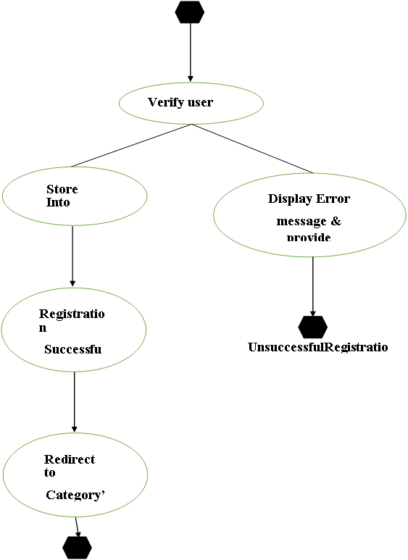
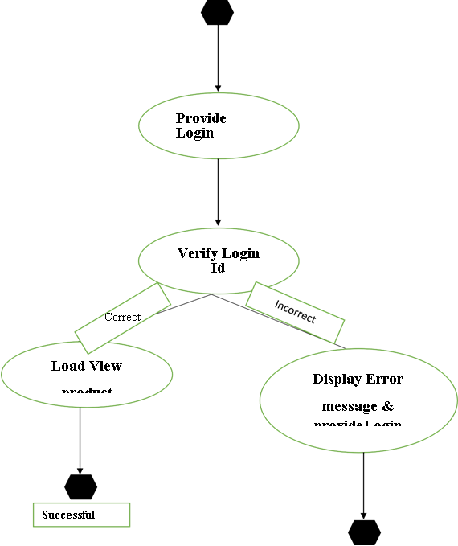
Activity Diagram Registration Activity
Login Activity

Slide 7
DFD – CRYPTO WALLET
Data Flow Diagram

Slide 8
LEVEL 0 DFD
View Currencies
Crypto Wallet
Application
user
Add Favrouite Coins

Slide 9
LEVEL 1 DFD
SignUp/
SignIn
(1)
isAuthorized
Check User Auth
user
Firebase DB
isAuthorized
isAuthorized
REQUEST/
RESPONSE
(2)
Request
Request
View Currencies
Firebase DB
Currency data
Responce
isAuthenticate
(3)
Request
Request
Add Favrouite Coin
Firebase DB
Currency data
isAuthenticated

Slide 10
LEVEL 2 DFD
| SignUp/SignIn
Check user account
SignUp/
SignIn
(1.1)
Request for SignUp/SignIn
Responce
Firebase DB
Authentication Done
Authentication Done
Home Page
(1.2)
Error Message
(1.2)

Slide 11
LEVEL 2 DFD
| View Currencies
Request
Check Internet
(2.1)
Online
isOnline
(2.2)
Responce
Requesting data
No internet
Currency data
Firebase DB
isOffline
(2.2)
No Connection
Offline UI
(2.3)

Slide 12
LEVEL 2 DFD
| Add Favrouite Coin
Request
isAuthenticate
(3.1)
isAuthenticate
Fetching data
(3.2)
Fav. Currency data
Requesting data
Not Authenticated
Currency data
Firebase DB
Coin Bucket Empty ui
(3.2)

Slide 13
DATA DICTIONARY
SR NO. | NAME | WHERE USE | HOW USE | DESCRIPTION
1 | Check user auth | SignUp /SignIn (1.1) | (1.1) I/ P | To check user account in db.
2 | Request for SignUp/SignIn | SignUp /SignIn (1.1) | (1.1 ) I/P | to request the new account.
3 | Responce | SignUp / SignIn (1.1) | (1.1) I/P | When user authorized then getting response.
4 | Authenticaton Done | HomePage (1.2) | (1.2) I/P | Authentication done.

Slide 14
DATA DICTIONARY
SR NO. | NAME | WHERE USE | HOW USE | DESCRIPTION
5 | Request | View Currencies (2.1) | (2.1) I/ P | App sent request to database.
6 | Online | View Currencies (2.2) | (2.1 ) I/P | User is online..
8 | Requesting data | View Currencies (2.2) | (2.2) I/P | User is online then it requesting data from the database.
9 | Currency data | View Currencies (2.2) | (2.2) I/P | Currency data got.

Slide 15
DATA DICTIONARY
SR NO. | NAME | WHERE USE | HOW USE | DESCRIPTION
9 | Responce | View Currencies (2.2) | (2.2) I/P | When user authorized then getting response shoe in application.
10 | No intenet | View Currencies (2.2) | (2.2 ) I/P | When user is offline .
11 | No Connection | View Currencies (2.3) | (2.1) I/P | User is offline then user can show offline UI.
12 | AuthenticatonDone | HomePage (1.2) | (1.2) I/P | Authentication done.

Slide 16
DATA DICTIONARY
SR NO. | NAME | WHERE USE | HOW USE | DESCRIPTION
13 | Request | Add Favrouite Coin (3.1) | (3.1) I/ P | App sent request to database.
14 | isAuthenticate | Add Favrouite Coin (3.1) | (3.1 ) I/P | Is user is authenticated.
15 | Fetching data | Add Favrouite Coin (3.2) | (3.2) I/P | User is online then it requesting data from the database.
16 | Not Authenticate | Add Favrouite Coin (3.2) | (3.2 ) I/P | Is user is not authenticated.

Slide 17
DATA DICTIONARY
SR NO. | NAME | WHERE USE | HOW USE | DESCRIPTION
17 | Currency Data | Add Favrouite Coin (3.2) | (3.2 ) I/P | When user request to show there fav. coins.
18 | User Interface | Add Favrouite Coin (3.2) | (3.2 ) I/P | Showing user’s favrouit coins.
19 | Null Currency data | Add Favrouite Coin (3.2) | (3.2) I/P | When user does not save there favouit coins then response will be null.
20 | Not Authotized | Add Favrouite Coin (3.2) | (3.2 ) I/P | Is user is not authenticated.
17

Slide 18
System Design Report for
Performance and Scalability
Discussion of system performance requirements.
Scalability considerations.
Caching and optimization strategies.
Executive Summary
A brief overview of the system design, its purpose, and key features.
The problem statement or need the system addresses.
Functionality
Detailed description of system features and functionalities.
Use cases or user stories.
Algorithms and business logic.
API and Integration
Explanation of API endpoints and data exchange.
Third-party integrations.
API documentation.
.
Security
Overview of security measures and practices.
Authentication and authorization mechanisms.
Data encryption and protection.
Deployment
Deployment architecture (e.g., cloud-based, on-premises).
Deployment process and tools.
Server and hosting requirements.

Slide 19
ER (Entity Relationship) Diagram
USER
CRYPTO
USER FAVOIRITES
CRYPTO
user_id
User_name
Email
Password
profile_image
Crypto_id
Crypto_name
Symbol
Price
market
Crypto_id
Crypto_name
Symbol
Price
market
User
Crypto

Slide 20

DATA DICTINARY
Firebase Database
When the system data store.
20

Slide 21
Firebase Database
Field Name | Data tpe | Description
Coin Id | String | This field represents the unique identifier for the cryptocurrency.
Name | String | The name of the cryptocurrency.
symbol | String | The symbol or icon of the cryptocurrency.
percentChange 1h | Double | This field represents the percentage change in the cryptocurrency's price over the last 1 hour.
21

Slide 22
Firebase Database
Field Name | Data tpe | Description
percentChange24h | Double | This field shows the percentage change in the cryptocurrency's price over the last 24hours.
percentChange30d | Double | This field shows the percentage change in the cryptocurrency's price over the last 30 days..
percentChange60d | Double | This field shows the percentage change in the cryptocurrency's price over the last 60 days.
percentChange 7d | Double | This field shows the percentage change in the cryptocurrency's price over the last 7 days.
22

Slide 23
Firebase Database
Field Name | Data tpe | Description
percentChange 90d | String | This field shows the percentage change in the cryptocurrency's price over the last 90 days.
price | String | The Current Price of the cryptocurrency.
volume24h | String | This field represents the trading volume of the cryptocurrency over the last 24 hours.
dateAdded2 | Date | This field represents a date associated with the cryptocurrency.
23

Slide 24
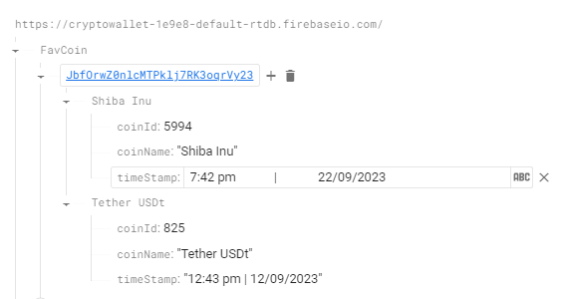
Real-Time Database For Fav. Coins
Field Name | Data tpe | Description
coinId | Long | This field represents the unique identifier for the cryptocurrency.
coinName | String | This field holds an instance of the CryptoCurrency class..
timeStamp | String | This field represents a timestamp (current date and time ) associated with the when coin is saved in real time database.
24

Slide 25
TESTING
Software testing is a process of running with intent of finding errors in the software.
Software testing assures the quality of software and represents the final review of other phase of the software like specification, design, code generation etc.

Slide 26
TESTING
Unit testing emphasizes the verification on the smallest unit of software design i.e. a software component or module.
Unit testing is the dynamic method for verification where program is actually compiled and executed, Unit Testing is performed in parallel with the coding phase.
Unit testing are units or module not the whole software.
I have tested each modules of application individually.
Tracking each and every kind of input and checking the corresponding output until the module is working correctly.
Testing two or more programs that depends on each other is called integration testing. Modules are typically code modules, individual applications, client and server, on a network, etc. integration testing follows unit testing and proceeds system testing.
UNIT TESTING
INTEGRATION TESTING

Slide 27
TESTING
It provides final assurance that software meets all functional, behavioral, and performance requirement, black box testing techniques is used
Validating application or website confirms to its specification and correctly perform all its required functions.
This entails a series of tests which perform a feature by future validation of behavior.
Using a wide range of normal and erroneous input data.
This can involve testing of the products user interface, APIs, database management, security, installation, networking, etc. testing can be performed on an automated or manual basis using black box or white box methodologies
FUNCTIONAL TESTING
VALIDATION TESTING

Slide 28
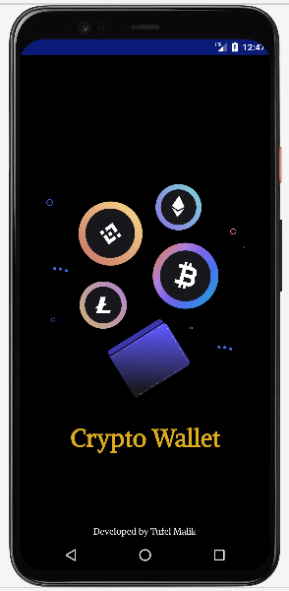
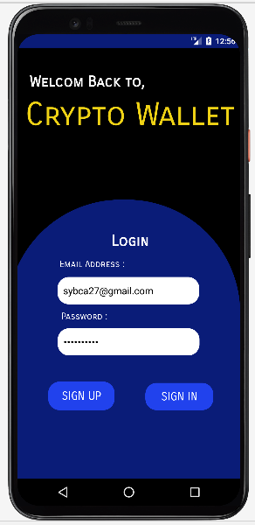
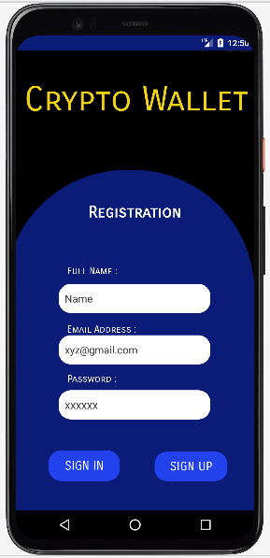
LAYOUT / OUTPUT OF APP
SPLASH SCREEN
LOGIN PAGE
REGISTRATION

Slide 29
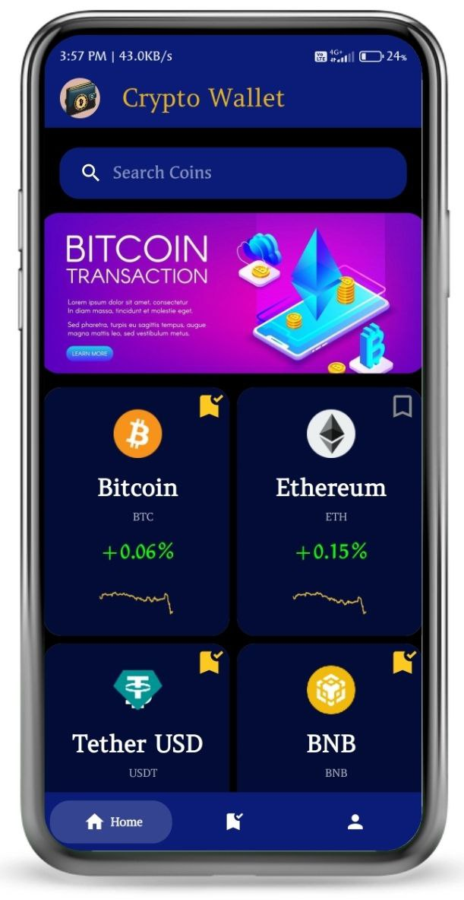
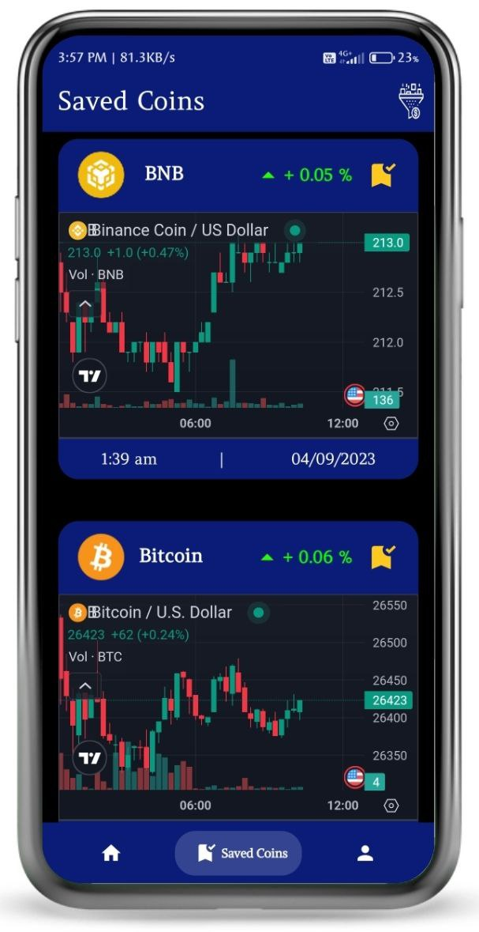
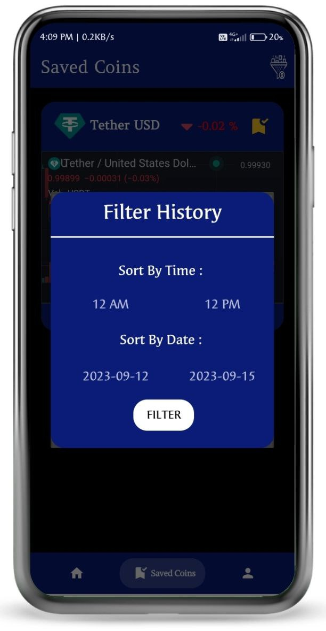
LAYOUT / OUTPUT OF APP
HOME PAGE
SAVED COIN PAGE
BEFORE FILTER

Slide 30
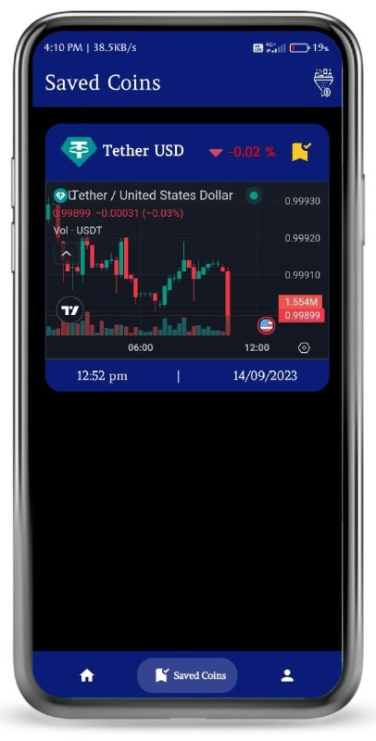
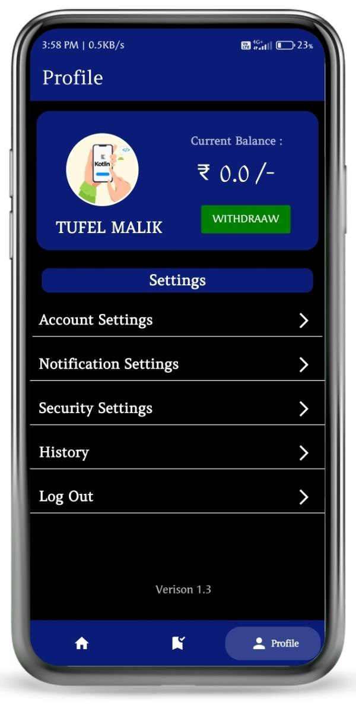
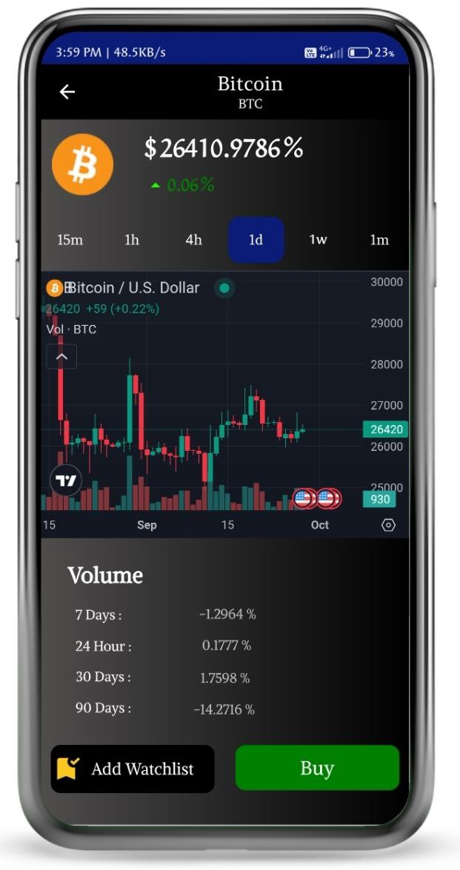
LAYOUT / OUTPUT OF APP
AFTER FILTERING
COINDETAILED PAGE
PROFILE PAGE

Slide 31
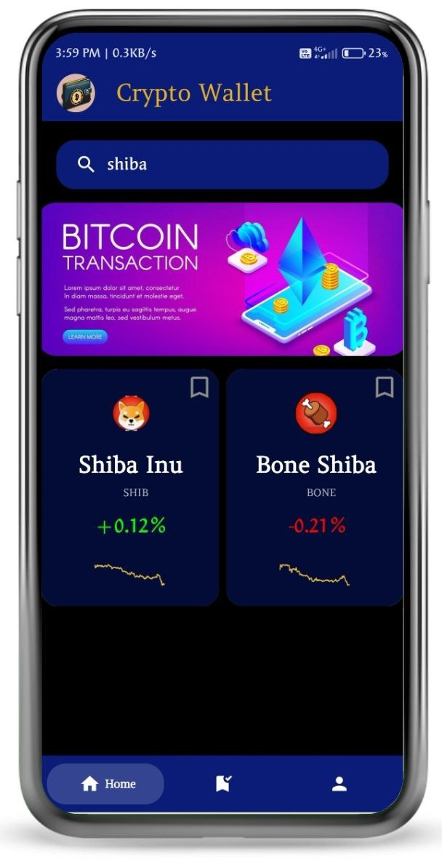
LAYOUT / OUTPUT OF APP
CLICK TO OPEN COIN DETAILS
SEARCHING COINS

Slide 32
Future Enhancement
In future iterations of your Kotlin-based crypto wallet app, you can enhance the user experience by introducing advanced filtering options for saved coin data, custom price alerts, historical data tracking, and portfolio management features.
Furthermore, integrating cryptocurrency news, community engagement, educational resources, graphical analytics, multi-wallet support, and backup and recovery mechanisms can provide users with a comprehensive and secure platform for managing their crypto investments.
To appeal to a global audience, consider internationalization, compliance with regulations, and cross-platform compatibility. Offering customization options, such as dark mode and theming, and providing widgets for quick access to live prices can make your app more versatile and user-friendly.

Slide 33
Refrences
"This crypto wallet app was developed with invaluable assistance from YouTube tutorials and Google's extensive documentation.
However, the core development process, logic, and implementation were crafted by me, reflecting my dedication to creating a practical and user-friendly application.
The combination of external resources and my hands-on approach resulted in a well-rounded and personally crafted crypto wallet solution.“
Feel free to customize this reference to align with your specific experiences and contributions during the app development process.

Slide 34



Thank You
Prepared by
TUFEL MALIK
MINOR PROJECT
21 BCA 19

